Slide 1
DIGITAL PORTFOLIO NAME : ACKSHAYA K NM ID: asbru072422K2360 DEPARTMENT:BSC CS COLLEGE:LRG GOVT ARTS COLLEGE FOR WOMEN

Slide 2
PROJECT TITLE
PORTFOLIO

Slide 3
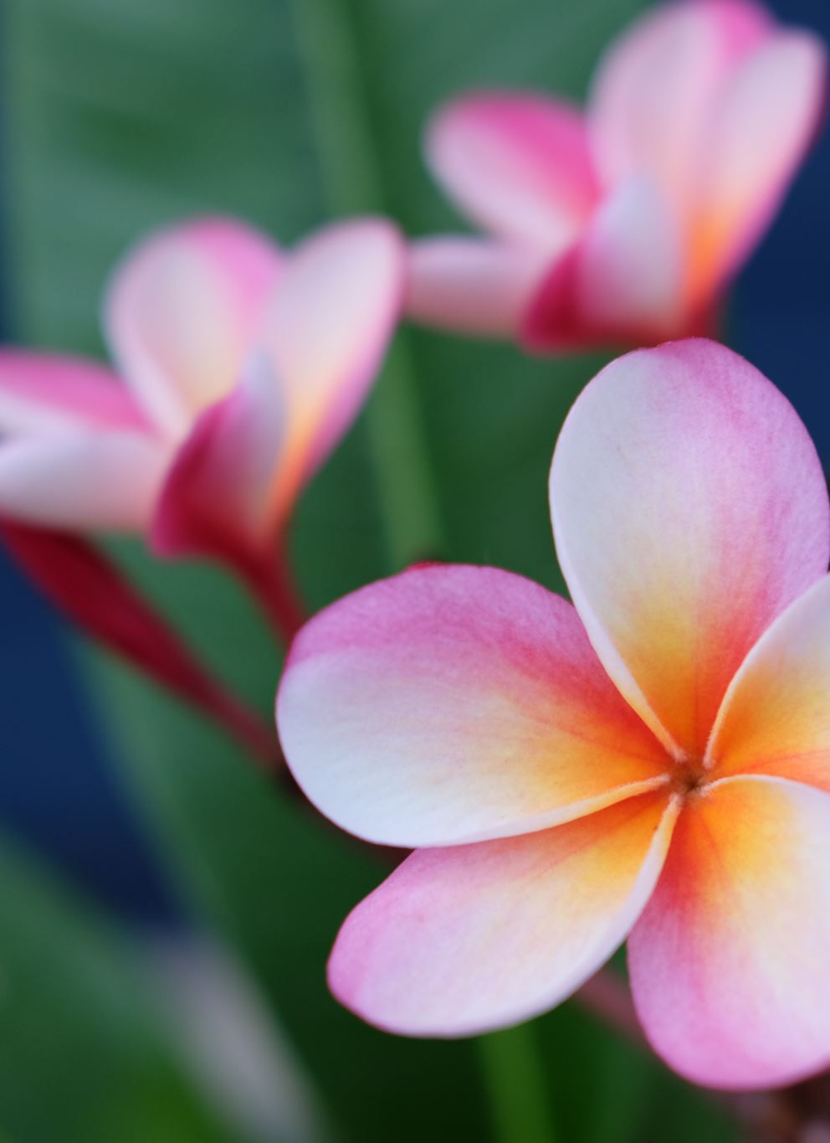
AGENDA 1.PROBLEM STATEMENT 2.PROJECT OVERVIEW 3.TOOLS AND TECHNOLOGY 4.PORTFOLIO DESIGN 5. RESULT AND SCREENSHOT 6.CONCLUSION 7.GITHUB LINK

Slide 4
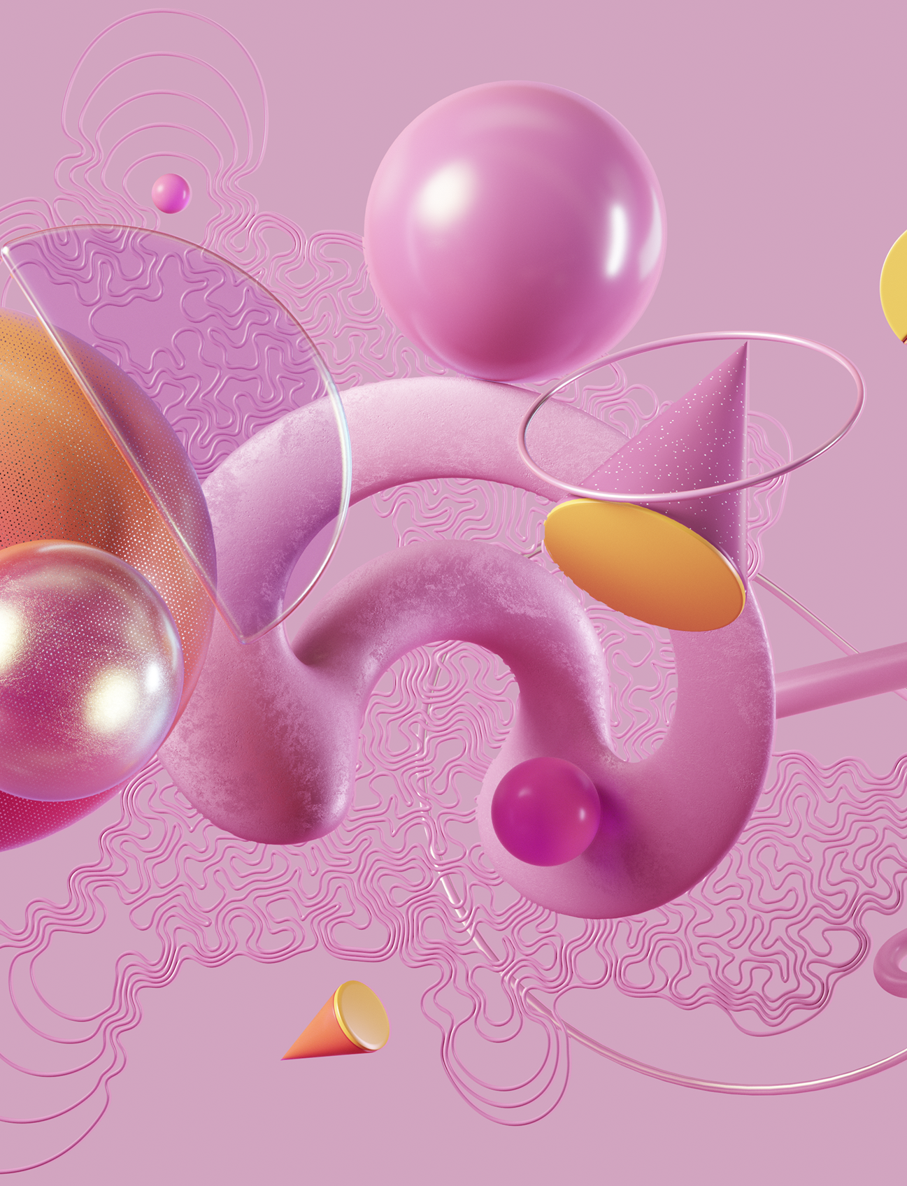
PROBLEM STATEMENT Many websites require user authentication, but poorly designed login forms can frustrate users and compromise by the form of security. This project aims to create a clean, responsive login form using HTML, CSS that enhances user experience and provides a solid foundation for future backend to the formal integration.

Slide 5
PROJECT OVERVIEW
GSAP Integration : Green sock animation platform for complex animations.
POSSIBLE APPLICATIONS :
Web design : Can be used as a creative element in web design to add visual interest and engagement.
Animation Showcase : Demonstrates capabilities of GSAP and Java script in creating complex animations.
TECHNOLOGIES USED :
HTML: Provides structure for the animation.
CSS: Styles the animation and adds visual effect.
Java script: Powers the animation using GSAP.

Slide 6
TOOLS AND TECHNIQUES
TECHNIQUES :
CSS Animations.
Java script Animation.
GSAP Animation.
Responsive Design.
TOOLS :
HTML.
CSS.
Java script.
GSAP.

Slide 7
PORTFOLIO DESIGN AND LAYOUT
DESIGN :
Color Scheme.
Style Fonts.
Shapes and Animation.
LAYOUT :
Grid System.
Adapting to different screen sizes.

Slide 8
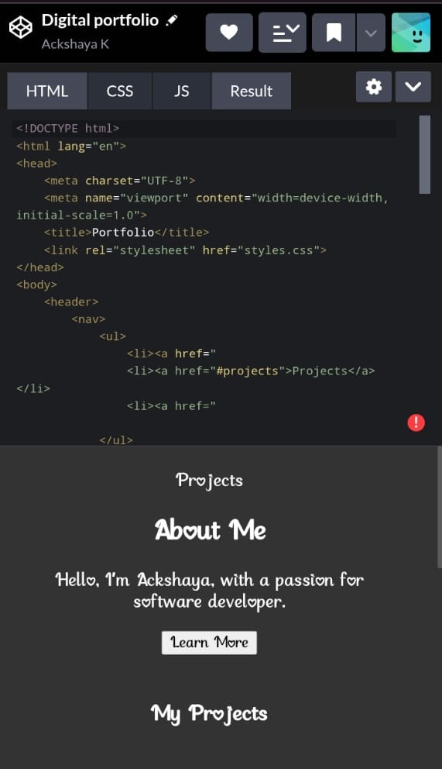
RESULT AND SCREENSHOT

Slide 9
CONCLUSION
The Codepen project is a great example of web design and animation skills , featuring a visually appealing design with creative animations and smooth transitions.

